Slide 1
Mystery Country
Bessie Moore Center for Economic Education
Wide World of Trade – Lesson 5

Slide 2
Detective
What does a detective do?
For this activity, you will be a detective

Slide 3
Clues --- Economic Information
Productive resources: Tells us a possible geographic location
  Natural resources
  Human resources
  Capital tools
Geography: land formations that can be used for economic activity
Economic System: way in which people, government and businesses interact to determine how to use the resources

Slide 4
Resources
Natural resources – gifts of nature
Human resources – quality and quantity of human effort directed toward production
Capital goods – goods produced and used to produce other goods
Human capital – skills, talent and education
  People who are healthier and produce more skills are more productive – producing more and different kinds of goods and services
  Can be improved through investments in education, training and health care
Notes:
Ex. 7th grade student can produce more and better projects than a first grade student; a student who practices piano will be much more skilled than one who does not;

Slide 5
Economic Information
Phones, electricity & transportation: how goods and services are produced & the quality of life
% of arable land: fit for growing crops
Literacy rate: tells us the types of skills and education of the workers
Notes:
How does electricity make life easier or better? Cooking, no need to gather fire wood; lights to read or work at night; heating & cooling; Phones & electricity facilitate communication; transportation provides means of getting to work, school, hospital and of transporting things that were produced to market. Communication makes it easier to educate people. Literacy rate – percentage of people who can read and write;

Slide 6
Economic Information
Increased productivity: producing more with the same amount of resources
Standard of living: level of goods and services people in a country have available to them
  Amount & quality of education
  Type of recreation
  Electricity for cooking, production and school
  Transportation
  Medical care

Slide 7
GDP
Gross Domestic Product:
  Measure of a country’s economic output
  Measures total value of a nations goods & services
  Produced in a given year
People must know the market value of goods and services
Capita means per person
Per capita GDP tells us how many goods and services are available to each person
Tells us something about standard of living
Does not tell us about distribution
Notes:
Does not include family farming or home production which does not have market value. Does not tell us about distribution of wealth.

Slide 8
Game Rules
Shout out the answer when you think you have it.
If your answer is incorrect, you do not get to guess again on that country.
The person who gets the correct answer first wins a prize.
Once you have won a prize, you can not guess again so as to let others have a chance!

Slide 9
Mystery Country 1
  Terrain: Mountainous, High Plateaus, Desert in the west
  GDP composition: agriculture (10%);industry (47%); services (43%)
  Trading partners: EU, US, Hong Kong
  Life Expectancy: 73.47 years
  GDP Per Capita: $8,500 (2011)
  Industries: Mining and Ore, Iron, Steel, Aluminum, Armaments
  Neighboring Countries: Mongolia, Nepal, Vietnam
Who am I?

Slide 10
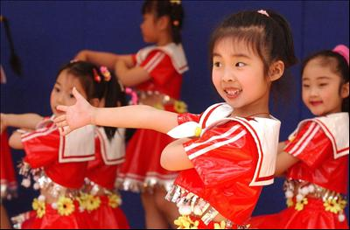
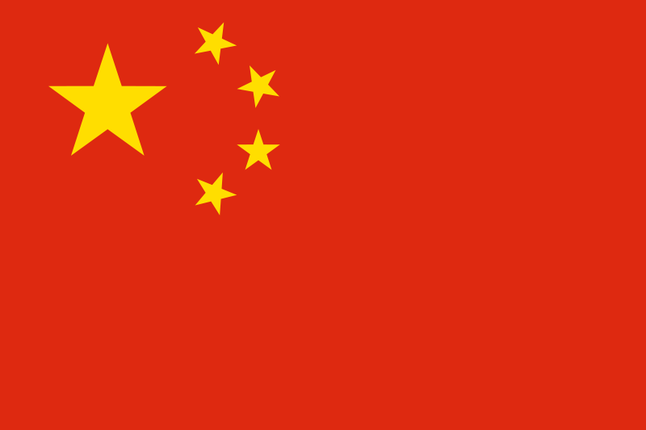
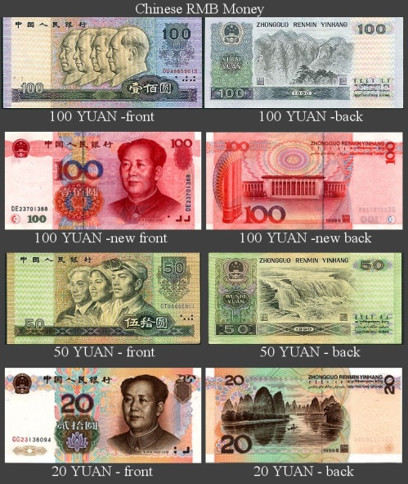
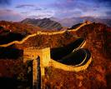
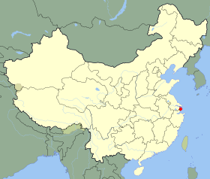

Mystery Country #1 is……
China

Slide 11
Mystery Country 2
  Agri. Products: Grain, Sugar Betts, Sunflower Seeds, Vegetables
  Trading Partners: Germany, Belarus, Italy, Netherlands, China
  Population: 140,041,247
  GDP per capita: $8,684
  Literacy Rate: Male – 99.7%, Female – 99.2 %
  Sports: Soccer, Ice Hockey, Ice Skating
  Currency: ruble
  Neighboring Countries: China, Kazakhstan, Mongolia
Who am I?

Slide 12
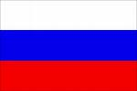
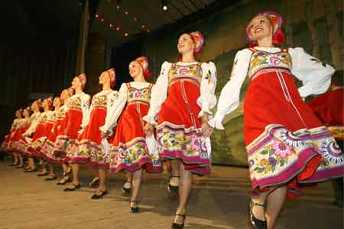

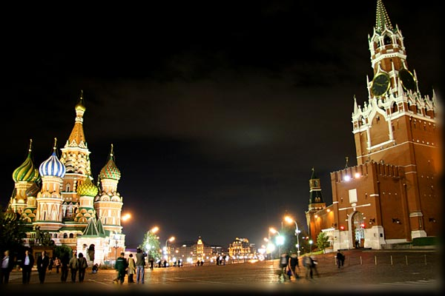
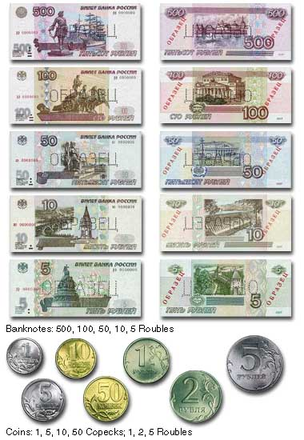
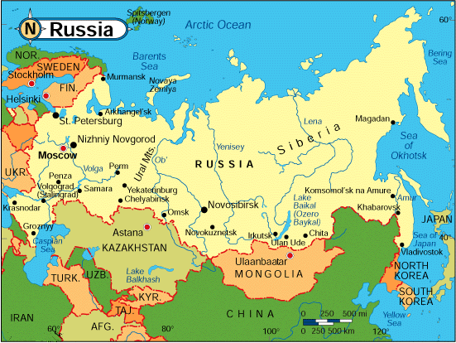
Mystery Country 2 is…..
Russia

Slide 13
Mystery Country 3
  Terrain: Flat lowlands, Mountains in the West, Tundra
  Natural Resources: Iron Ore, Copper, Zinc, Timber
  Known for quality of pre-K programs
  Life Expectancy: 80.86 years
  Literacy Rate: Male – 99%, Female – 99%
  GDP Per Capita: $38,500
  Industries: Iron and Steel, Precision Equipment, Paper Products
Who am I?

Slide 14

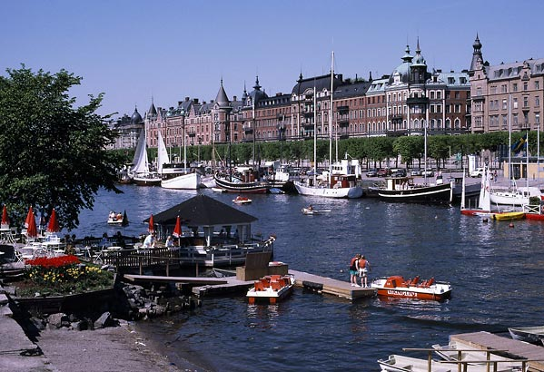
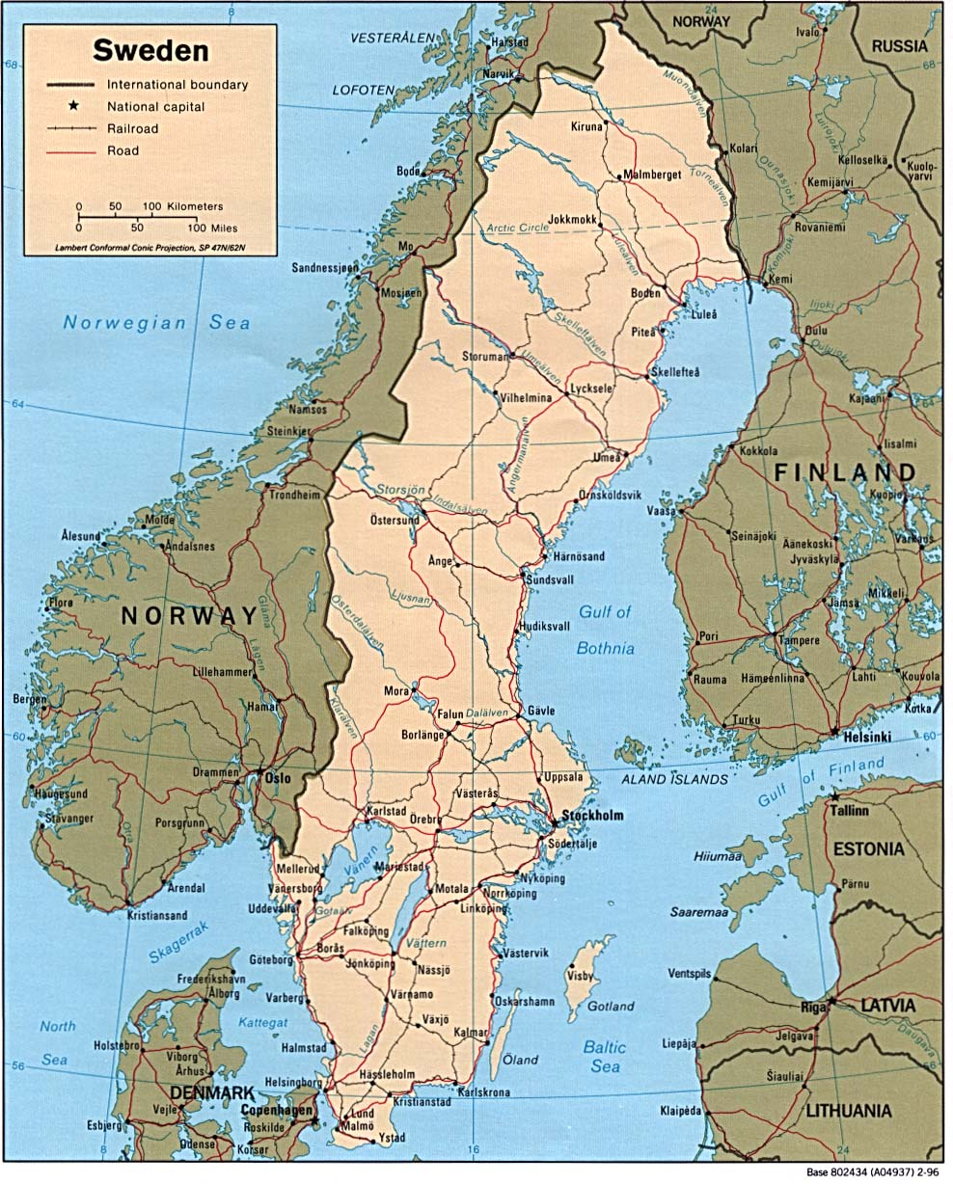
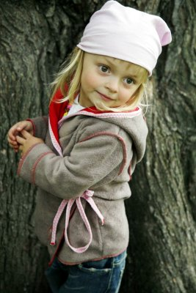
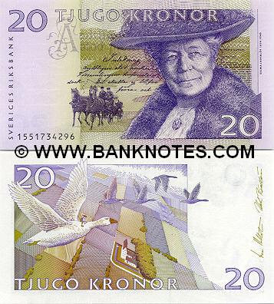
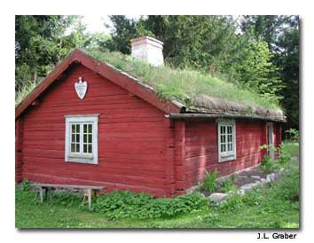

Mystery Country 3 is…..
Sweden

Slide 15
Mystery Country 4
Industries: Sugar, Cement, Textiles, Beverages, Wood products
Neighboring countries: Brazil, Argentina, Bolivia
Natural resources: Hydropower, Timber, Iron Ore
Population: 6,995,655
Life expectancy: 75.77 years
GDP per capita: $4,200
Neighboring countries: Brazil, Argentina, Bolivia
6)
Who am I?

Slide 16

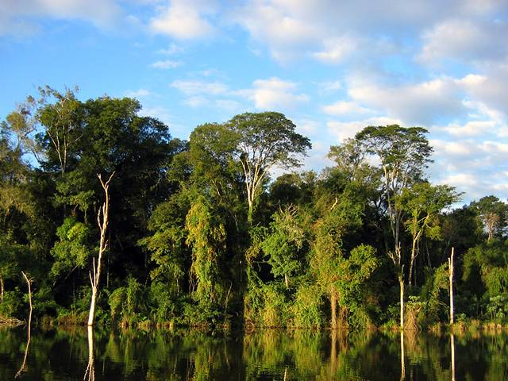
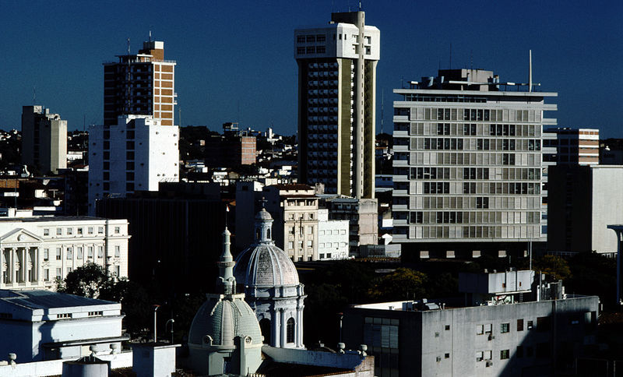
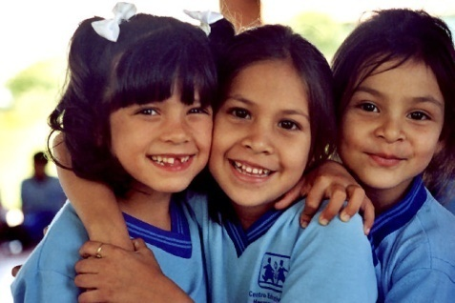
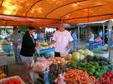
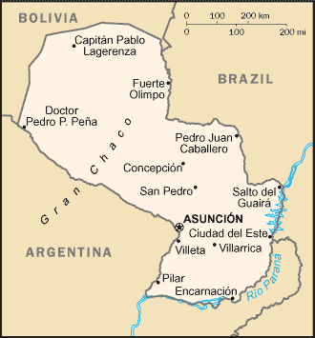
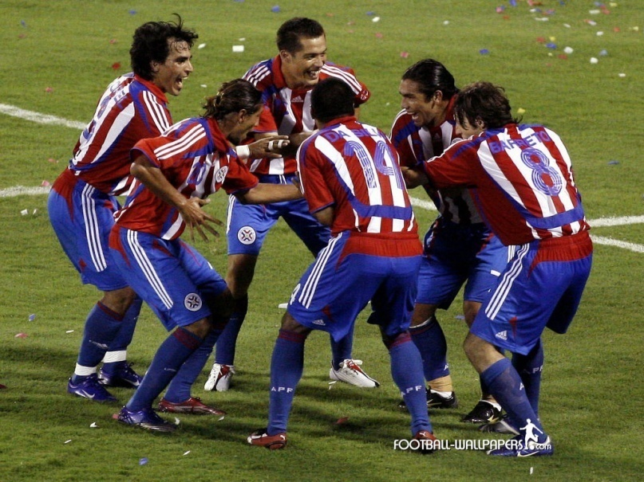
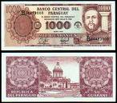
Mystery Country #4 is . . .
Paraguay

Slide 17
Mystery Country 5
  Terrain: Interior plateau, Rugged hills, and Coastal plains
  Natural Resources: Gold, Chromium, Gem Diamonds, Platinum
  Population: 49,052,489
  Food: Bobotie, Rock Lobster
  Life Expectancy: 48.98 years
  GDP Per Capita: $10,000
  Industries: Mining, Auto Assembly, Metalworking
Who am I?

Slide 18

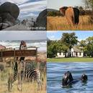
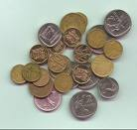
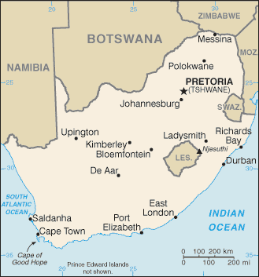
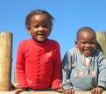
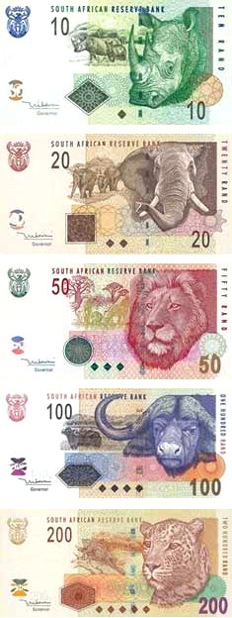
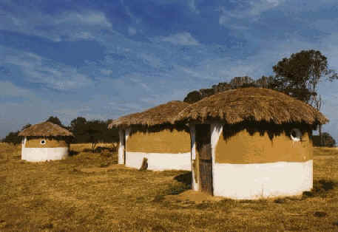
Mystery Country 5 is…..
South Africa

Slide 19
Mystery Country 6
  Agri. Products: Corn, Wheat, Soybeans, Rice, Beans
  Trading Partners: United States, Canada, Japan, China
  Electricity Consumed: 202 billion kWh
  GDP per capita: $8,143
  Currency: peso
  Sports: Soccer, Basketball
  Food: Flatus, Red Enchiladas
  Neighboring Countries: United States, Guatemala, Belize
Who am I?

Slide 20

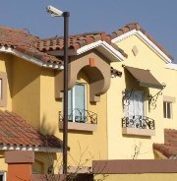
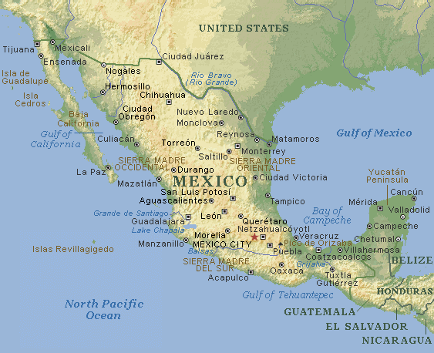
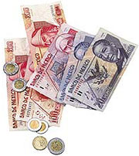
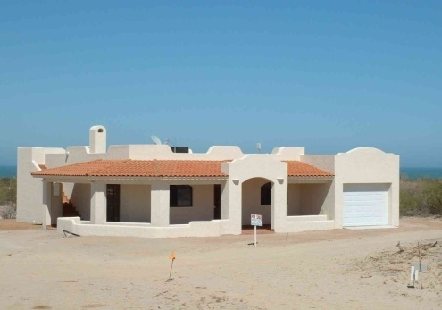
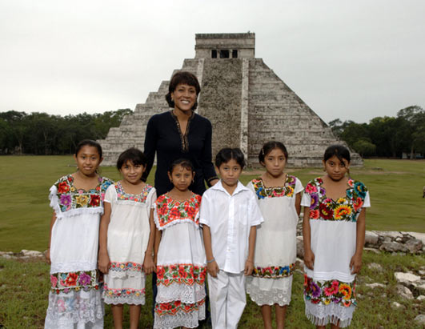

Mystery Country 6 is……
Mexico

Slide 21
Mystery Country 7
  Terrain: Rolling lowlands, Jungle, Hills
  Natural Resources: Bauxite, Gold, Iron Ore, Nickel
  Life Expectancy: 71.99 years
  Literacy Rate: Male – 88.4%, Female – 88.8%
  GDP Per Capita: $10,100
  Industries: Textiles, Shoes, Chemicals, Cement, Lumber
  Currency: real
  Neighboring Countries: Colombia, Venezuela, Peru, Bolivia
Who am I?

Slide 22


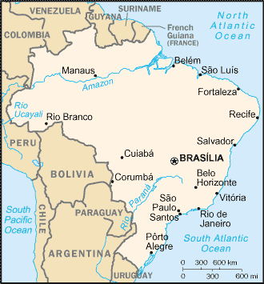
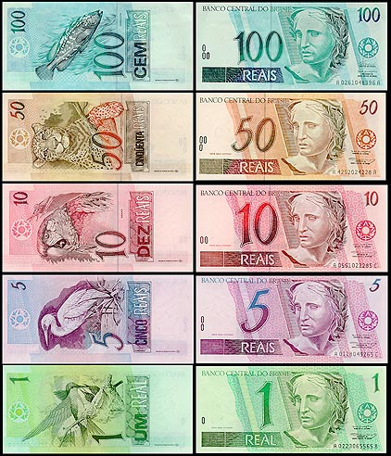
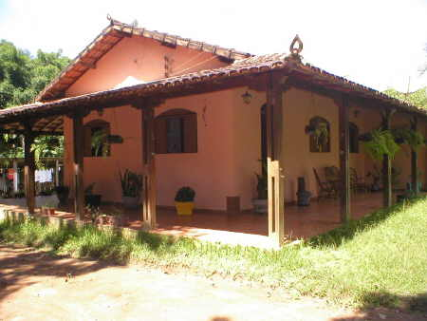

Mystery Country 7 is……
Brazil

Slide 23
Mystery Country 8
  Terrain: Plains in the South, Mountains in the North, Desert in the West
  Natural Resources: Coal, Iron Ore, Manganese, Diamonds
  Sports: Cricket, Chess, Films
  Literacy Rate: Male – 73.4%, Female – 47.8%
  GDP Per Capita: $2,800
  Currency: rupee
  Food: Curry, Masala, Kobbari
Who am I?

Slide 24

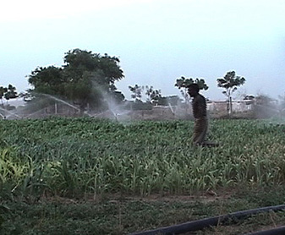
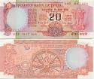
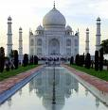
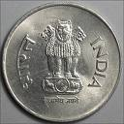

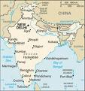

Mystery Country 8 is…..
India

Slide 25
Mystery Country 9
  Terrain: Plains in the central, Mountains in the East and West, Sub-tropical in the southeast
  Population: 307,212,123
  Life Expectancy: 78.11 years
  GDP Per Capita: $47,000
  Industries: Petroleum, Steel, Motor Vehicles, Aerospace, Telecomm
  Sports: Baseball, Football, Basketball
  Currency: dollar
Who am I?

Slide 26

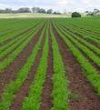

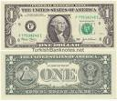
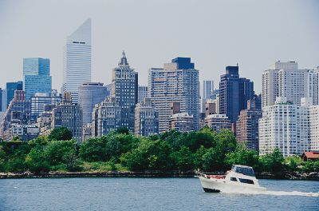


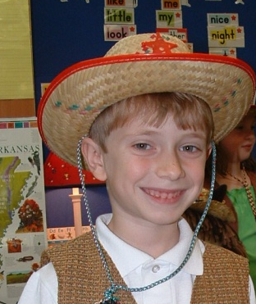

Mystery Country 9 is…..
United States

Slide 27
Mystery Country 10
  Terrain: Lowlands
  Natural Resources: Fish, Deepwater Port
  Life Expectancy: 81.98 years
  Literacy Rate: Male – 69.6%, Female – 8.6%
  GDP Per Capita: $52,000
  Industries: Electronics, Chemicals, Financial Services, Rubber processing
  Currency: dollar
  Neighboring Countries: Indonesia, Malaysia
Who am I?

Slide 28
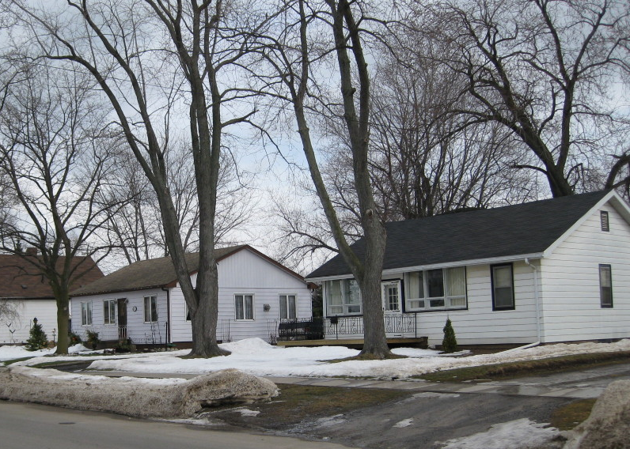

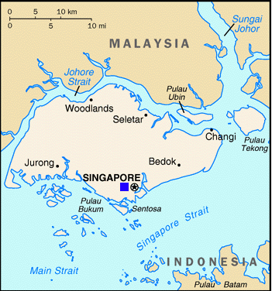

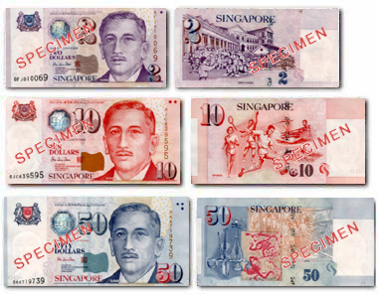
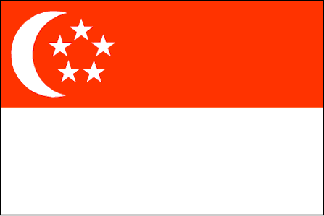
Mystery Country 10 is….
Singapore

Slide 29
Mystery Country 11
Ranked as upper-middle income economy by World Bank
GDP per capita is $14,413 (2011)
Exports copper, fruit, fish products, pepper and pulp & wine
Export partners: China, Japan, US, Brazil & S. Korea
Import partners: US, China, Argentina, Brazil
Currency is peso
Has lots of coastal area, mountains, deserts and tundra
Who am I?

Slide 30
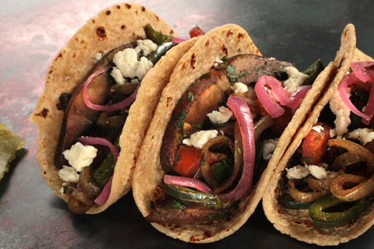




Mystery Country 11 is….
CHILE

Slide 31
Mystery Country 12
Per capita income of $81,800 – 5th richest country in world.
Extensive modern and well-maintained highways.
Production: crude oil, shipping, construction, cement, water desalination & financial services.
Imports most foods with the exception of fish.
Second most free economy in the Middle East.
Who am I?

Slide 32







Mystery Country 12 is….
KUWAIT
Notes:
Kuwait

Slide 33
Mystery Country 12

Slide 34
Mystery Country 12 is . . .
Notes:
Estonia https://www.cia.gov/library/publications/the-world-factbook/geos/en.html - estonia

Slide 35
Economic Development
Better health care
More and better education
Infrastructure
Technology
Effective government without corruption
Trade

Slide 36
Activity 1:
Adopt a country.
Learn about it’s culture and economy.
Compare life there to life in your country.
What did you find interesting about your adopted country?
If you needed to emigrate to find work, which country would be of interest to you?
To which country would you like to travel for a vacation?
Notes:
Singapore

Slide 37
Activity 2:
Have students create their own slides showing information and photos of countries of the world.
  GDP per capita - Name and photo of currency
  Literacy rate - Flag and description
  Exports & imports - Trading partners
  Location
Notes:
Amy – credits for curriculum guide

Slide 38
Activity 3
Go the kids page of the CIA for an overview and grade level activities
Using the CIA World Factbook, explore the country comparisons & flags of the world
Decide in which country you would want to live based on GDP per capita.

Slide 39
Activity 4
Have students use the CIA World Factbook to learn environment issues for each country. Under geography – environment.
Include definitions of:
  Air pollution
  Water shortages
  Water pollution
  Deforestation
  Erosion
  Desertification
  Trade in endangered species

Slide 40
Activity 5: Resources
The World Bank
CIA World Factbook
Infoplease: All the knowledge you need

