Slide 1
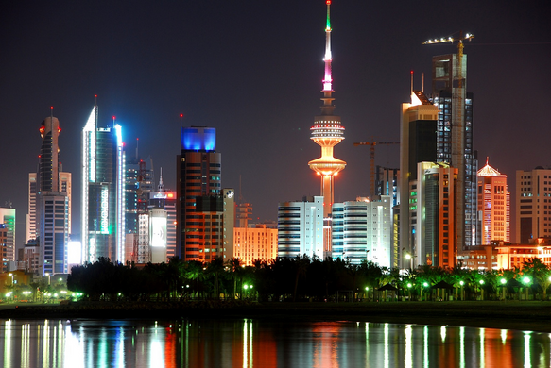
KUWAIT
By,
Kawthar Habeeb

Slide 2
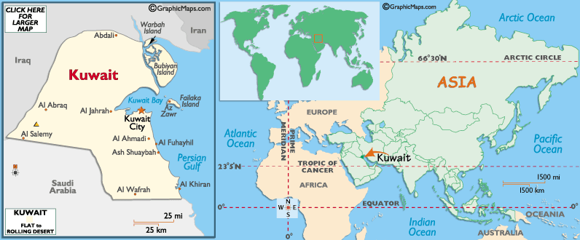
Kuwait
Middle East, bordering the Arabian Gulf, between Iraq and Saudi Arabia
Fast Facts:

Slide 3
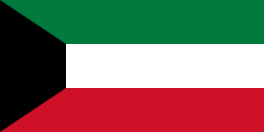
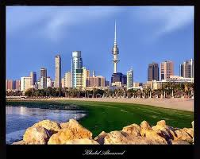
Kuwait
Fast Facts:
Geography
Area: 17,820 sq. km. (6,880 sq. mi.); approximately the size of the State of New
Jersey.
Cities: Capital--Kuwait City.
Terrain: Almost entirely flat desert plain.
Climate: Summers are intensely hot and dry with average highs ranging from
108o-120oF, winters are short (Dec.-Feb.) and cool, averaging
50o-80oF, with limited rain.

Slide 4
Kuwait
Fast Facts:
Population :
3,632,009
including approximately 1.16 million Kuwaiti citizens,
2.47 million non-Kuwaiti nationals, and
100,000 stateless persons.
Approximately 68% of the total population is non-Kuwaiti
Annual population growth rate (2011 est.): 2%
Ethnic groups: Kuwaiti 32%, other Arab 27%, South Asian 37%, other 4%.
Religion: Muslim estimated 85% (Sunni 70%, Shi'a 30% among Kuwaitis), with sizable Hindu, Christian, and Buddhist communities.
Languages: Arabic (official).
Education: free at all levels for Kuwaitis, including higher education. Adult literacy 93.3% for the total population (age 15 and over, 2009; male 94.4%, female 91%).
Work force (2009 est.): 2.091 million (75% male, 25% female; 20% Kuwaiti citizens). Kuwait has a sizable foreign labor force (approximately 68% of the total population is non-Kuwaiti).
Notes:
Kuwait's 93.3% literacy rate, one of the Arab world's highest, is the result of extensive government support for the education system. Public school education, including Kuwait University, is free, but access is restricted for foreign residents. The government sponsors the foreign study of qualified students abroad for degrees not offered at Kuwait University.

Slide 5
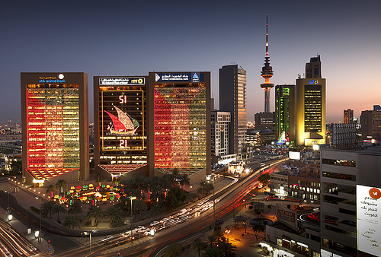
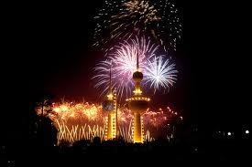
Kuwait
Fast Facts:
Government
Type: constitutional, hereditary emirate ruled by princes (Amirs) who have been drawn from
the Al Sabah family since the middle of the 18th century.
Independence: June 19, 1961 (from the United Kingdom).
Administrative subdivisions: Six. governorates
Political parties: None; formal political parties have no
legal status, although de facto political blocs exist.
Elections: There are no executive branch elections; the Amir is hereditary; prime minister
and crown prince are appointed by the Amir.

Slide 6
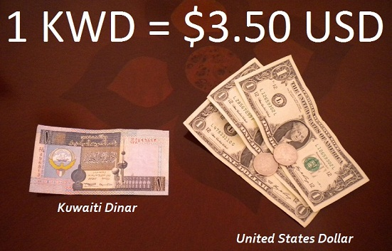
Kuwait
Fast Facts:
Economy
Kuwait is a geographically small but wealthy country with a relatively open economy and self-reported crude oil reserves of nearly 105 billion barrels--approximately 8% of world reserves. Petroleum accounts for nearly half of GDP, 95% of export revenues, and 95% of government income.

Slide 7
GDP - per capita (PPP): $40,700 (2011 est.) .
Real GDP growth rate (2010 est.): 4.4%.
Natural resources: Oil, natural gas, fish, shrimp
Notes:
Gross domestic product / Free On Board or Freight On Board

Slide 8
Agriculture and fishing (about 8.02% of GDP): With the exception of fish, most food is imported. Cultivated land--1%.
Industry: Types--oil and gas (about 43.35% of GDP) including petroleum extraction and refining, fertilizer, chemicals, desalination, construction materials.
Notes:
Agriculture is limited by the lack of water and arable land. The government has experimented in growing food through hydroponics and carefully managed farms. However, much of the soil that was suitable for farming in south central Kuwait was destroyed when Iraqi troops set fire to oil wells in the area and created vast "oil lakes." Fish and shrimp are plentiful in territorial waters, and large-scale commercial fishing has been undertaken locally and in the Indian Ocean.

Slide 9
Manufacturing: About 5.14% of GDP.
Services (about 30% of GDP): Types--public administration, real estate, trade, hotels, and restaurants.
Financial institutions: About 13.49% of GDP.
Shipping : The Kuwait Oil Tanker Company has 24 crude oil, liquefied petroleum gas, and refined product carriers and is the largest tanker company in an OPEC country. Kuwait is a member of the United Arab Shipping Company.
Notes:
Organization of the Petroleum Exporting Countries

Slide 10
Trade (2010 est.):
Exports : $65.98 billion f.o.b.: oil (93%).
Major markets--Japan 17%, South Korea 18.8%, India 15.1%, U.S. 7.6%, Singapore 8.1%, China 12.9%, Taiwan 11.9%.
Imports : $19.4 billion f.o.b.: food, construction materials, vehicles and parts, clothing.
Major suppliers : U.S. 10.8%, Japan 7.2%, Germany 7.6%, China 12%, Saudi Arabia 5.9%, Italy 4.4%, U.K. 3.2%, India 5.4%, U.A.E. 4.2%, South Korea 4.2% (2009).
Notes:
f.o.b.: Free On Board or Freight On Board

Slide 11
Industry and Development
Industry in Kuwait consists of several large export-oriented petrochemical units, oil refineries, and a range of small manufacturers. It also includes large water desalinization, ammonia, desulphurization, fertilizer, brick, block, and cement plants. The U.S. and Kuwaiti governments signed a Trade and Investment Framework (TIFA) agreement in 2004, providing a forum to address mutual trade concerns and needed economic reforms. Kuwait and the other GCC nations signed a free trade agreement with Singapore in 2008, and with the European Free Trade Association (EFTA) in 2009. Kuwait does not attract significant foreign direct investment (FDI), largely due to bureaucratic obstacles and barriers to doing business in Kuwait.

Slide 12
Kuwait is a member of the UN and some of its specialized and related agencies, including the World Bank (IBRD), International Monetary Fund (IMF), World Trade Organization (WTO), African Development Bank (AFDB), Arab Fund for Economic and Social Development (AFESD), Arab League, Arab Monetary Fund (AMF), Council of Arab Economic Unity (CAEU), Economic and Social Commission for Western Asia (ESCWA), Group of 77 (G-77), Gulf Cooperation Council (GCC), INMARSAT, International Development Association (IDA), International Finance Corporation, International Fund for Agricultural Development, International Labor Organization (ILO), International Maritime Organization, Interpol, International Olympic Committee, Islamic Development Bank (IDB), International Federation of Red Cross and Red Crescent Societies, Non-Aligned Movement, Organization of Arab Petroleum Exporting Countries (OAPEC), Organization of Islamic Cooperation (OIC), Organization of Petroleum Exporting Countries (OPEC), and the International Atomic Energy Agency (IAEA).

Slide 13

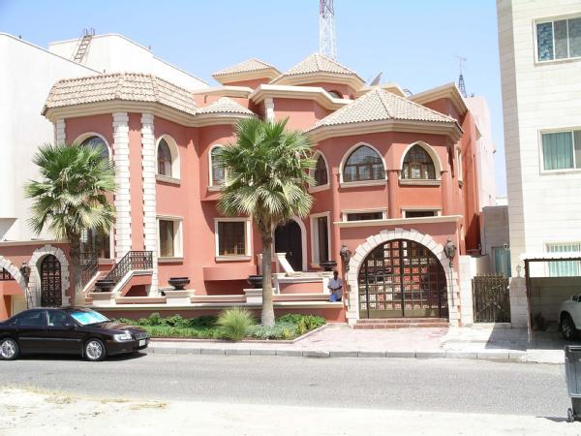
Kuwait
Fast Facts:
Social Benefits
The government has sponsored many social welfare, public works, and development plans financed with oil and investment revenues. Among the benefits for Kuwaiti citizens are retirement income, marriage bonuses, housing loans, virtually guaranteed employment, free medical services, and education at all levels.
By Amiri decree, the government occasionally disburses a portion of its budget surplus as a grant to all Kuwaiti citizens.
Foreign nationals residing in Kuwait do not have access to these welfare services. The right to own stock in publicly traded companies, real estate, and banks or a majority interest in a business is limited to Kuwaiti citizens and citizens of Gulf Cooperation Council (GCC) countries under limited circumstances.
Notes:
Keep in mind that Kuwait is a tax free country!

Slide 14
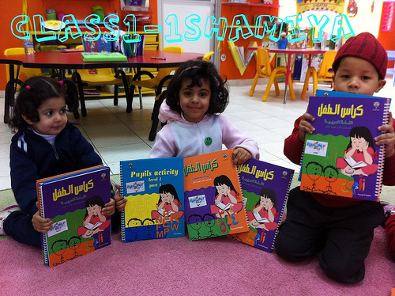
Kuwait
Fast Facts:
Education
There are two main ministries involved in the development of the education sector: the Ministry of Education and the Ministry of Higher of Education.
The general education system consists of four levels:
kindergarten(lasting for 2 years),
primary (lasting for 5 years),
middle school (lasting for 4 years) and
high school (lasting for 3 years.)
All the levels including higher education are free.
There are 3 state-funded higher education institutions in Kuwait, namely
Kuwait University,
the College of Basic Education, and
the Higher Institutes for Theater and the Music Arts.

Slide 15

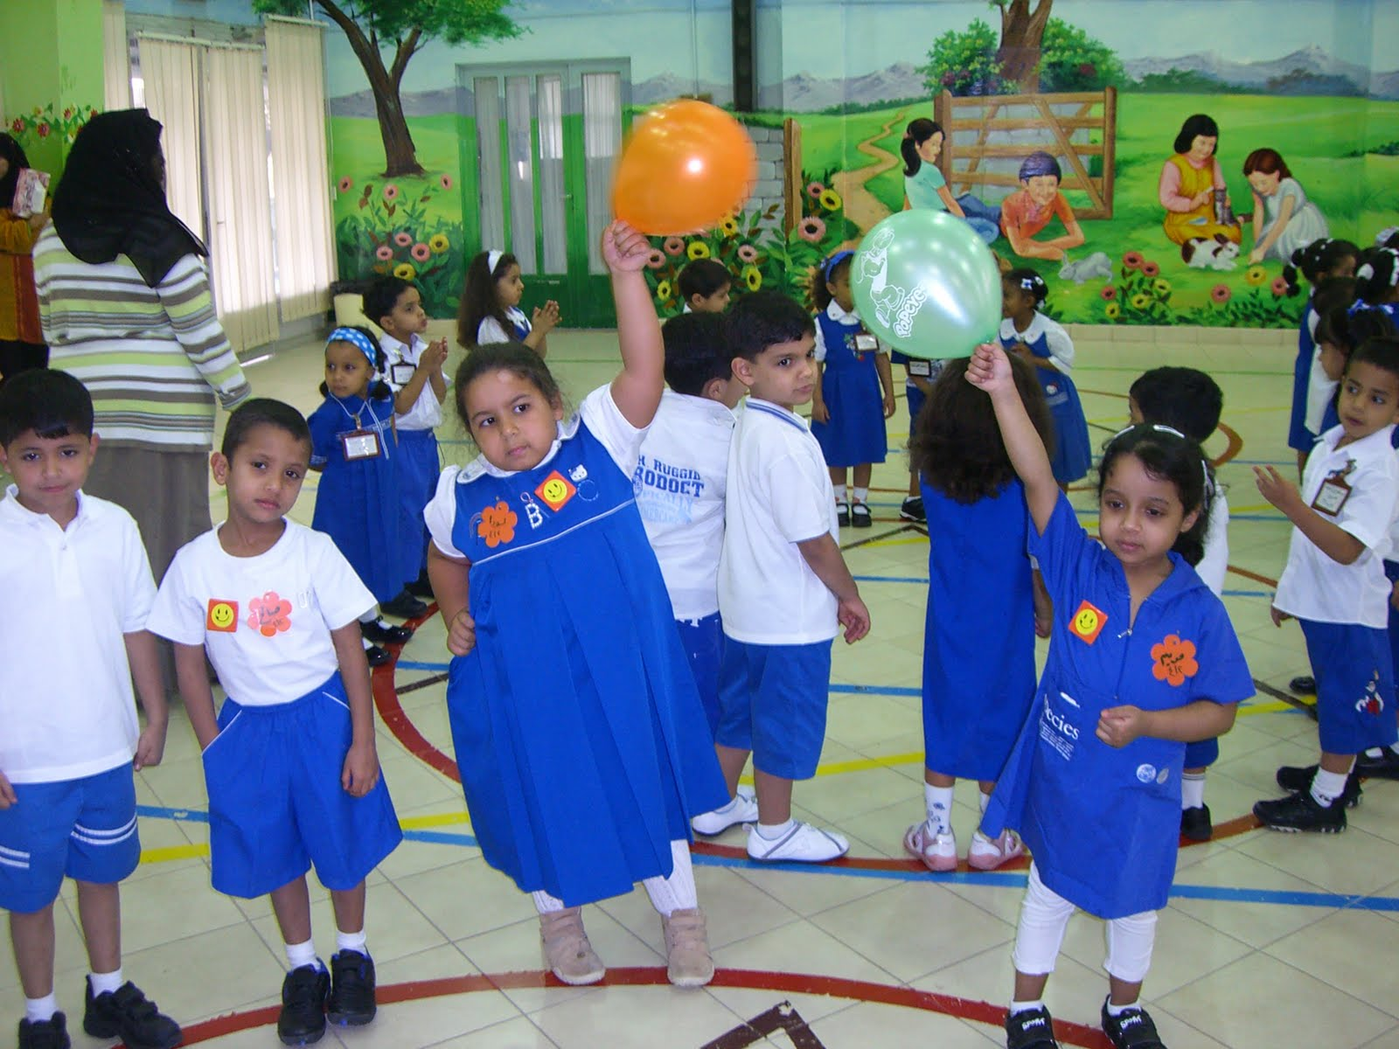
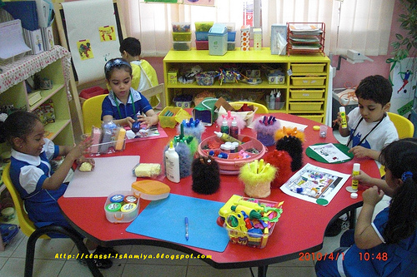
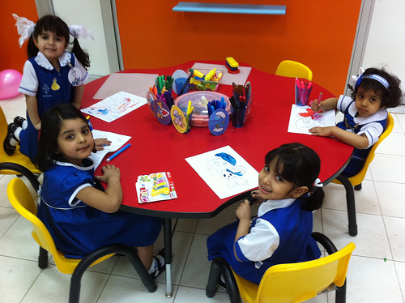

Slide 16
http://www.ifitweremyhome.com/compare/US/KW

Slide 17
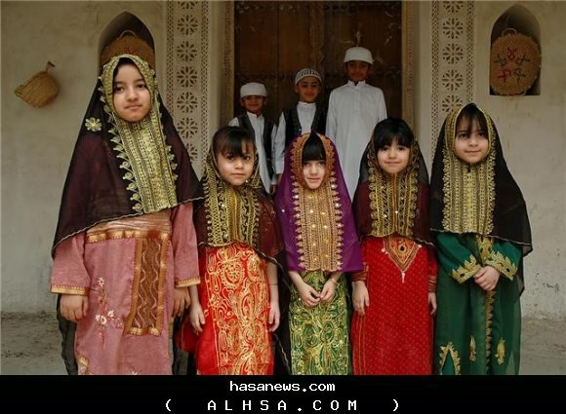

Slide 18

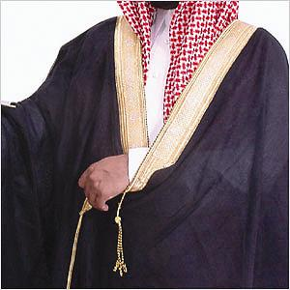
Deshdasha Besht Ghutra

Slide 19
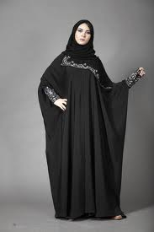
Abaaia -
Malfaa

Slide 20
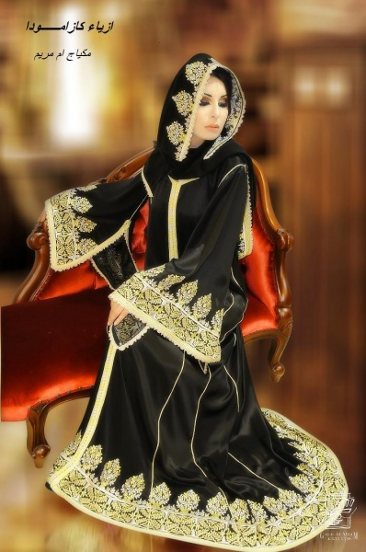

Slide 21
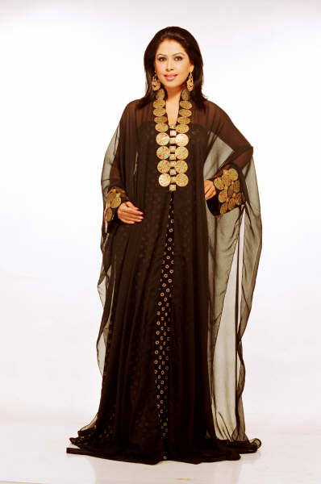

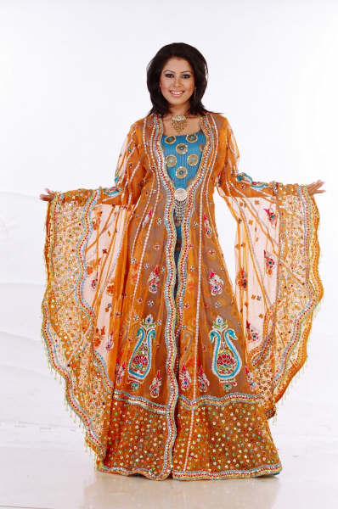
Darraa

Slide 22




Slide 23
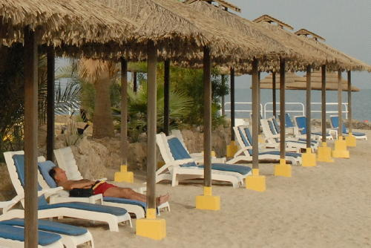
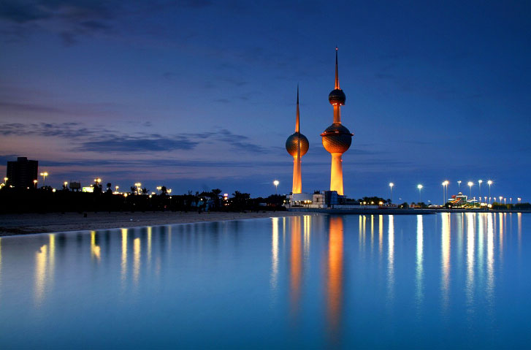

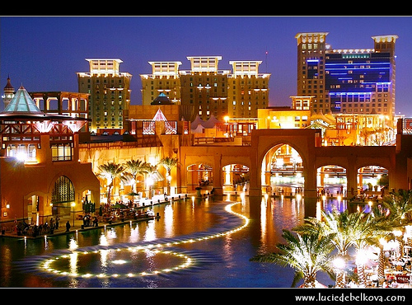

Slide 24
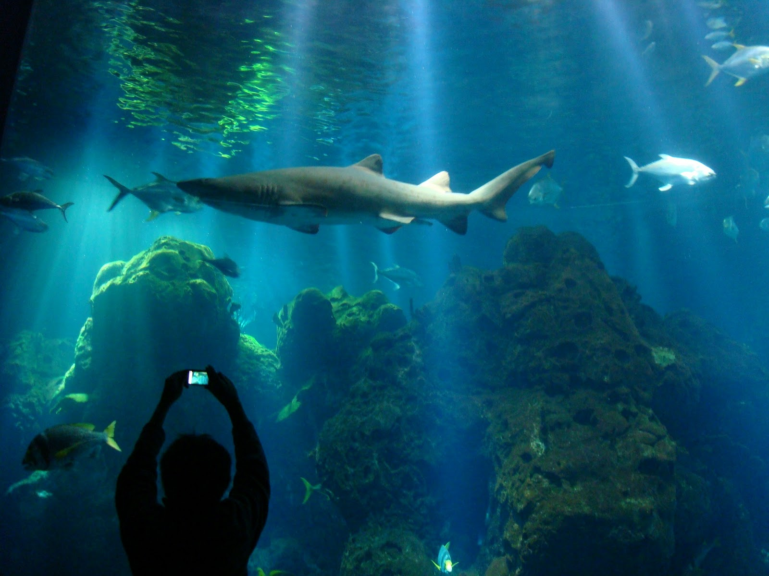
Kuwait Aquarium

Slide 25
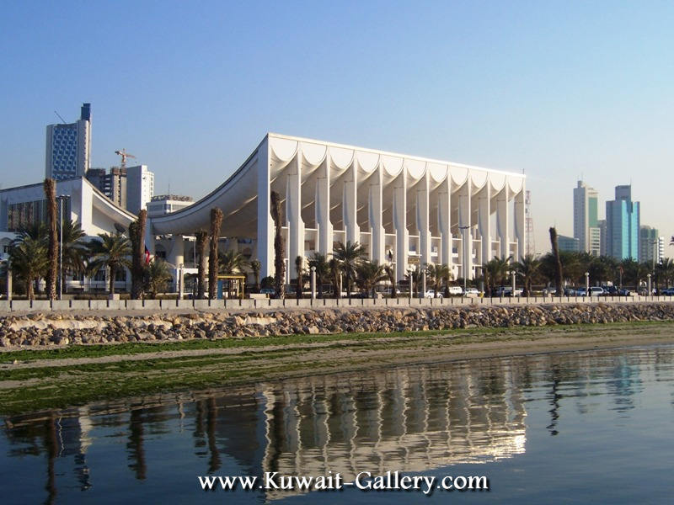
Parliament building

Slide 26
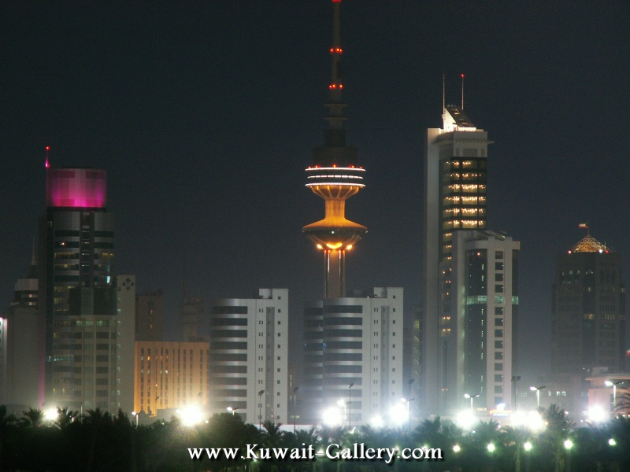

Slide 27
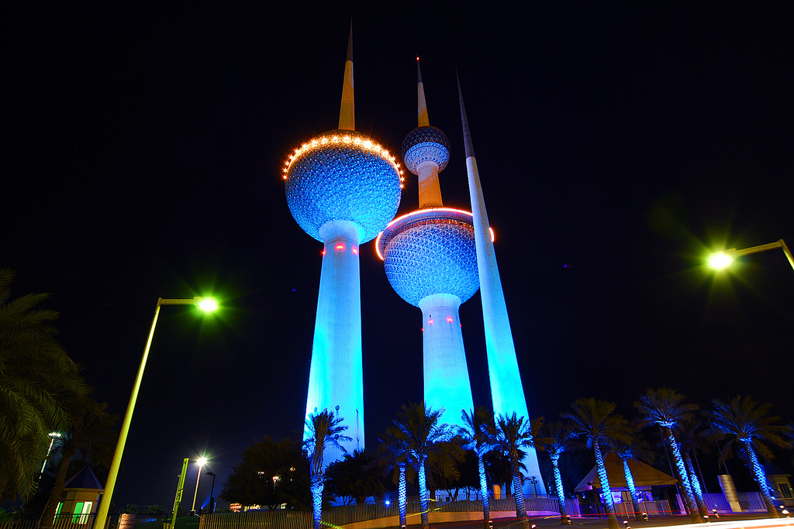
Kuwait Towers
Kuwait Towers
Kuwait Towers

Slide 28
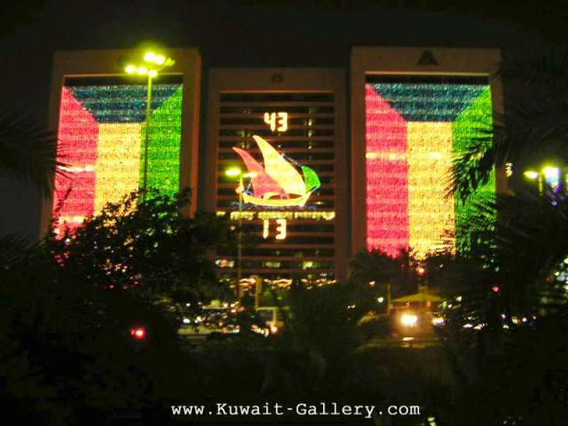

Slide 29
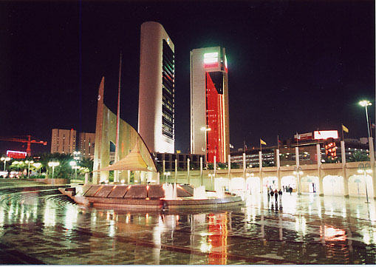

Slide 30
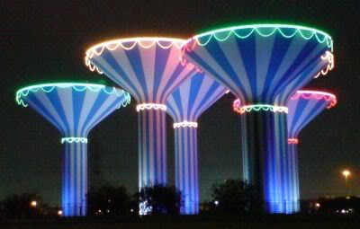
Reserve water tanks

Slide 31
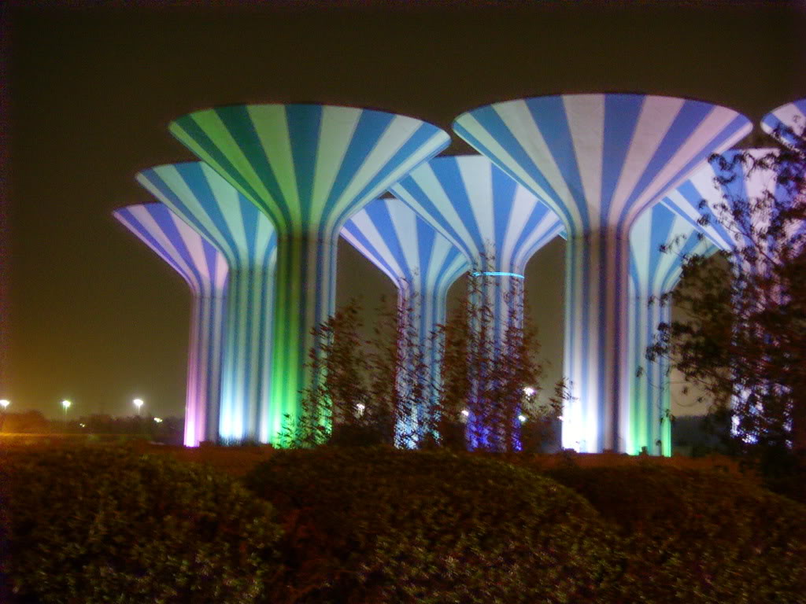

Slide 32
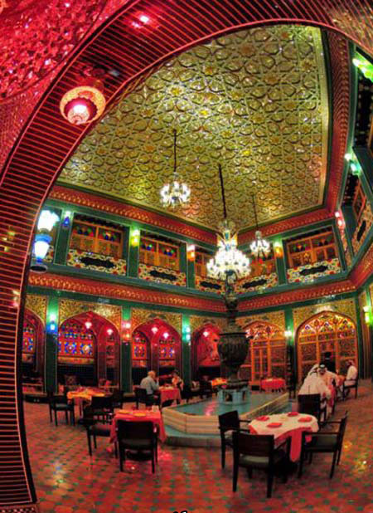
Restaurant

Slide 33
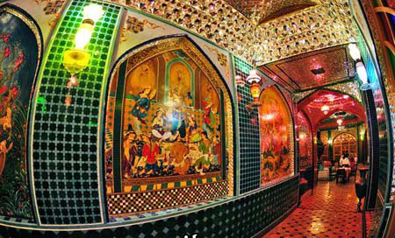
Restaurant

Slide 34
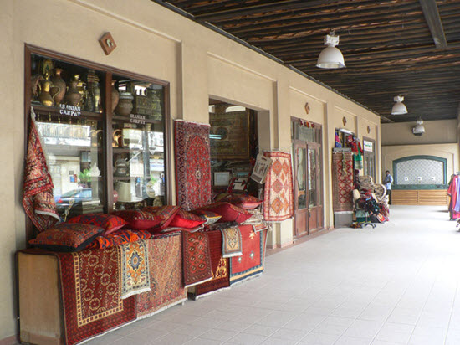
Traditional Kuwait Markets

Slide 35
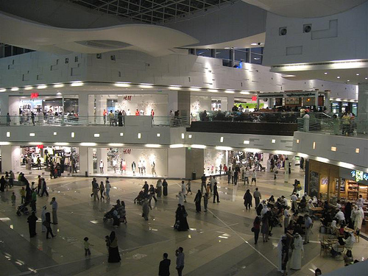
The Avenues center, the largest shopping mall in Kuwait

Slide 36
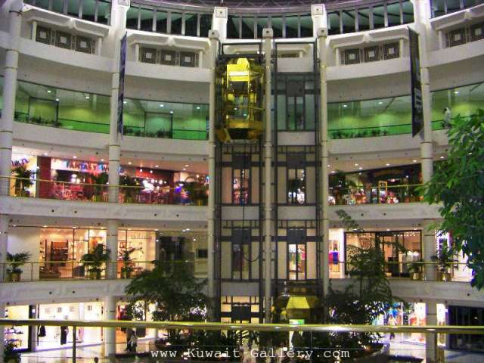
Al-Mohalab Mall

Slide 37
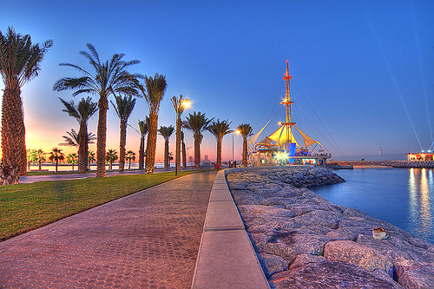
Kuwait marina beach

Slide 38
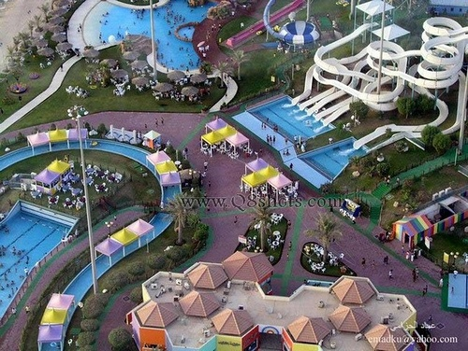
Kuwait Aqua Park

Slide 39
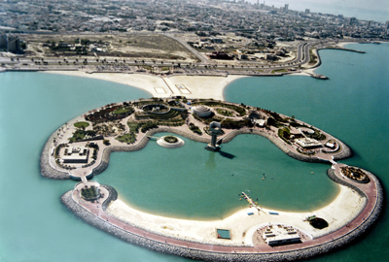
Artificial island

Slide 40
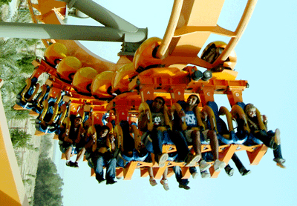
Kuwait entertainment city

Slide 41
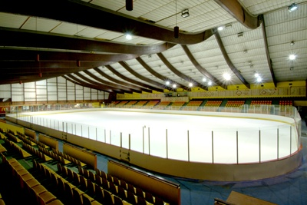
Kuwait Ice Skating Rink

Slide 42
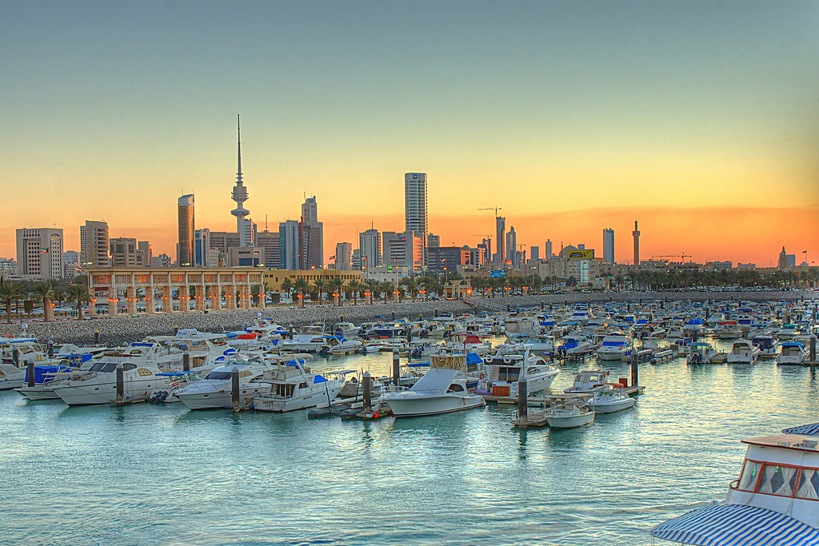
Sharq marina

Slide 43
Kuwait City

Slide 44
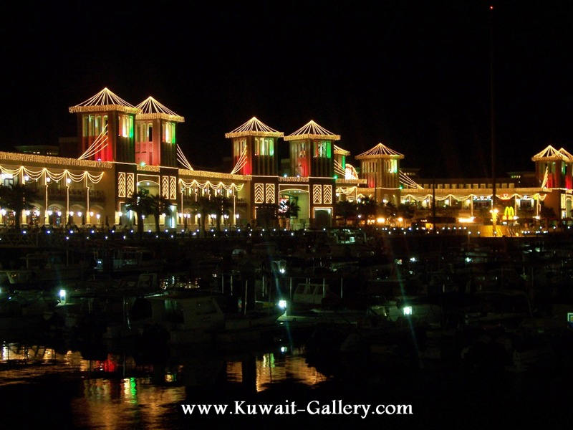
kuwait Sharq Mall

Slide 45
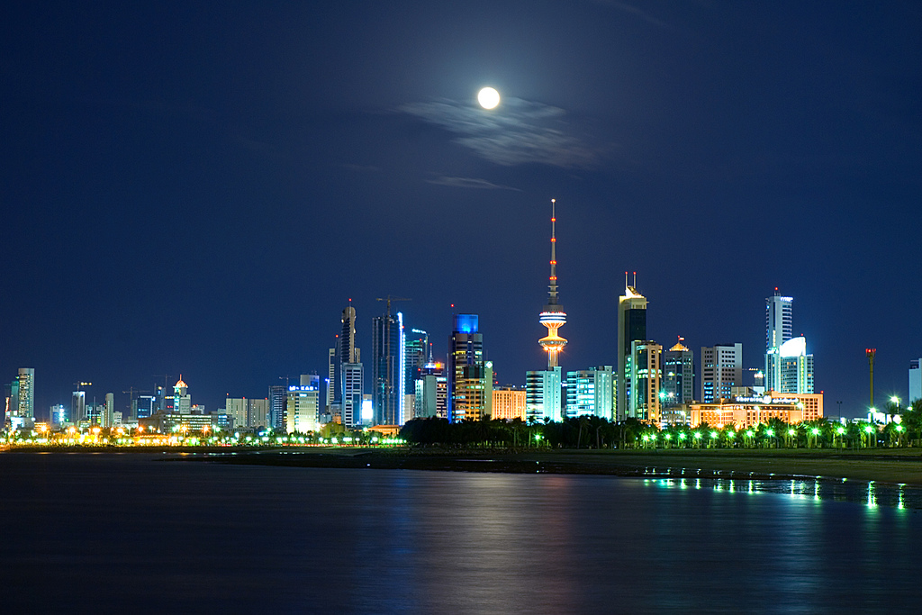
Kuwait city

Slide 46
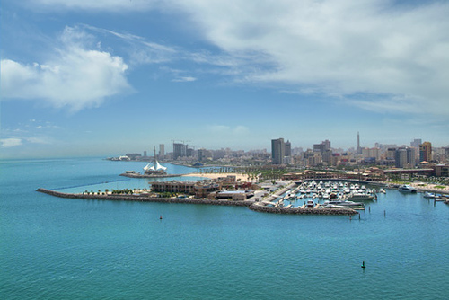

Thank You
Presentation created by Kawthar Habeeb

