Slide 1
The Arkansas World Trade Center
Connecting Arkansas to the World
Insert Company Logo
Presentation by
Emile Phaneuf

Slide 2
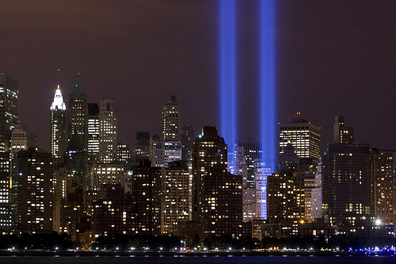
The Dream Lives On
The Towers of Light, Ground Zero, New York

Slide 3
World Trade Center Association
The World Trade Center Association:
Established in 1970 to facilitate international trade
Includes over 300 World Trade Centers
Present in over 100 countries
Affiliated with over 750,000 WTCA members

Slide 4
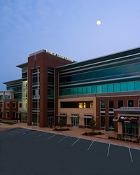
Arkansas World Trade Center
Mission Statement
The mission of the Arkansas World Trade Center is to connect Arkansas to the world by providing international trade services to companies and individuals and by educating students in global commerce.

Slide 5
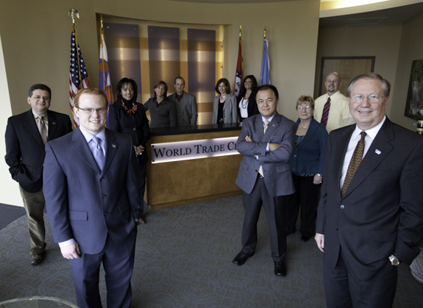
Arkansas World Trade Center

Slide 6
What Trade Means to Arkansas
$4.9 Billion in Manufactured Goods Exports (2007)
$1.9 Billion of Agricultural Exports (2006)
189,000 Manufacturing Jobs
22,600 Agricultural Jobs
33,900 Arkansans Employed by Foreign Companies
12,896,887 tons ($58 million) of cargo moved on Arkansas River (2004)

Slide 7
What Trade Means to Arkansas
Civilian Aircraft
Arkansas’ largest export commodity valued at
$1.67 billion in 2009
Agricultural Products
Rice: Arkansas’ 3rd largest export valued at
$224 million in 2009
Poultry: Arkansas’ is 2nd largest poultry
producer in the US
Manufacturing Products
Manufactured commodities exported valued at
$355 million for May 2010

Slide 8
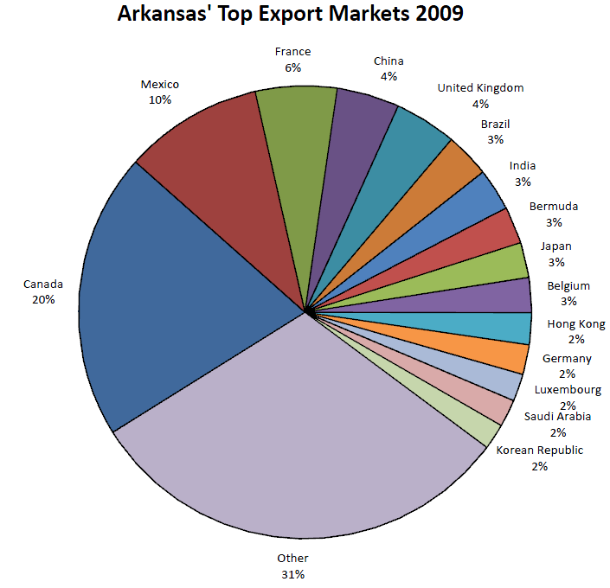

Slide 9
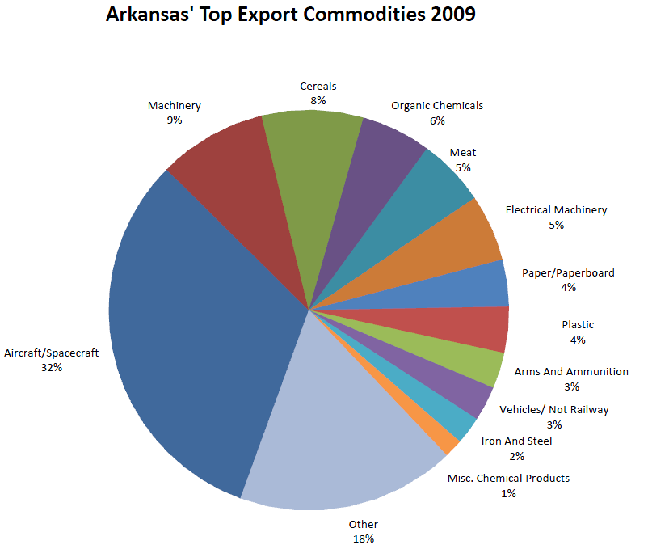

Slide 10
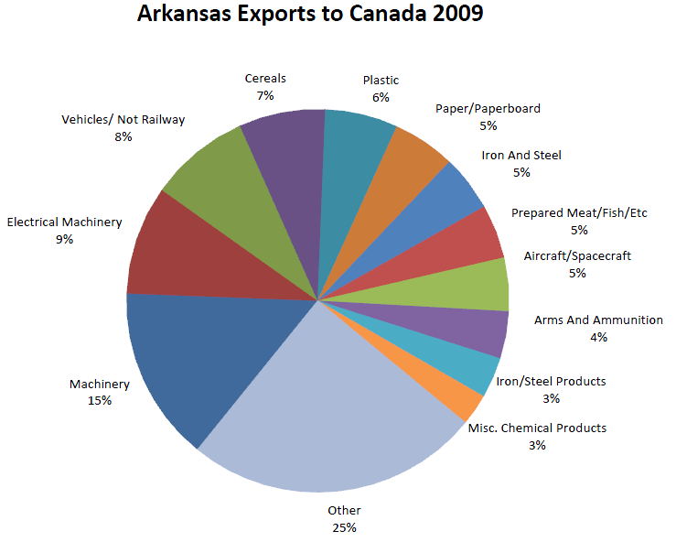

Slide 11
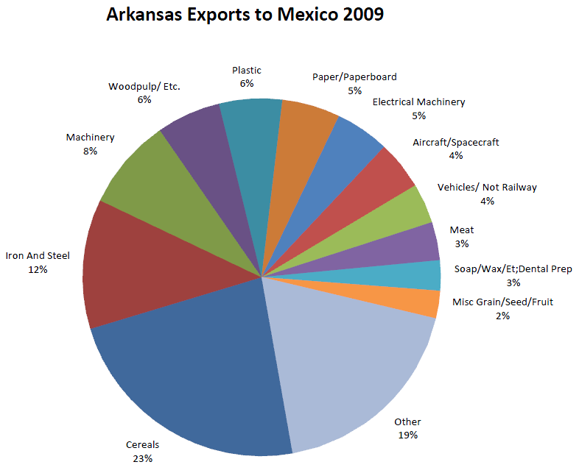

Slide 12
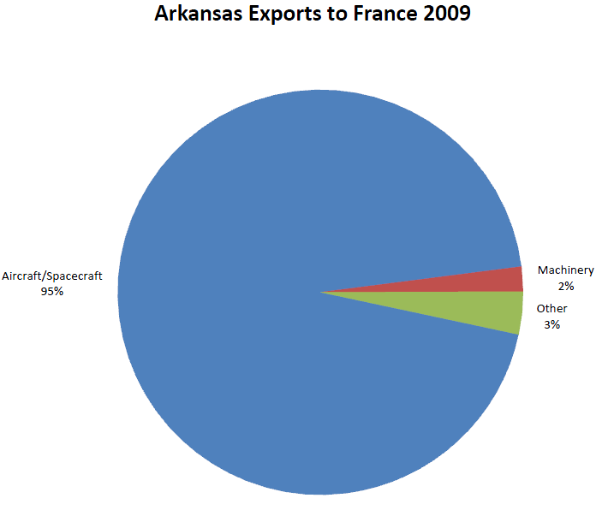

Slide 13
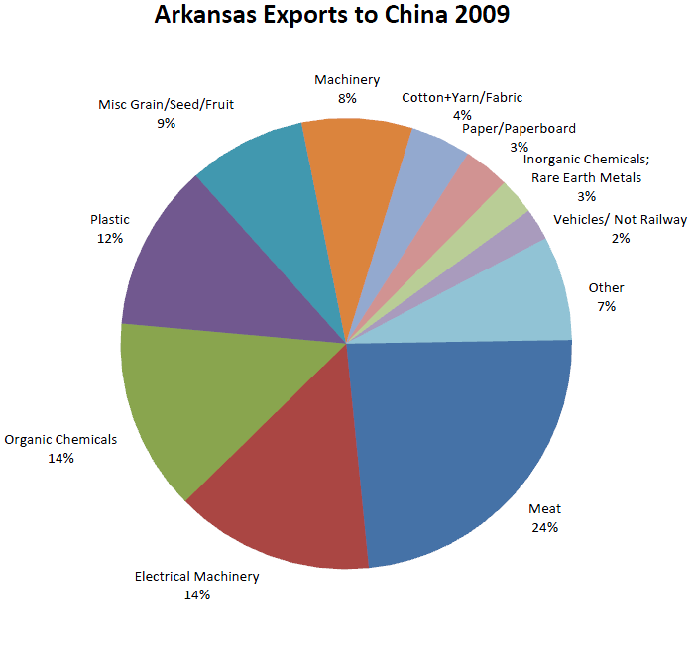

Slide 14
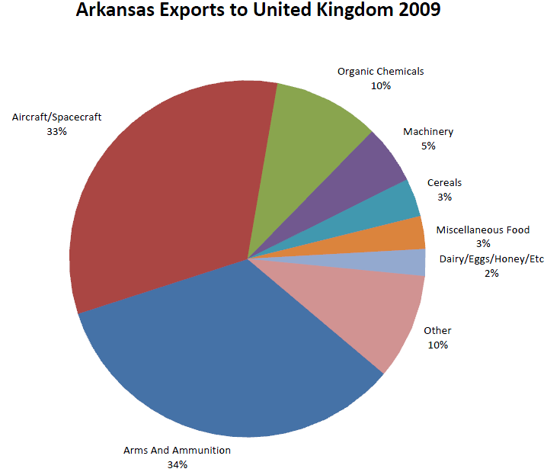

Slide 15
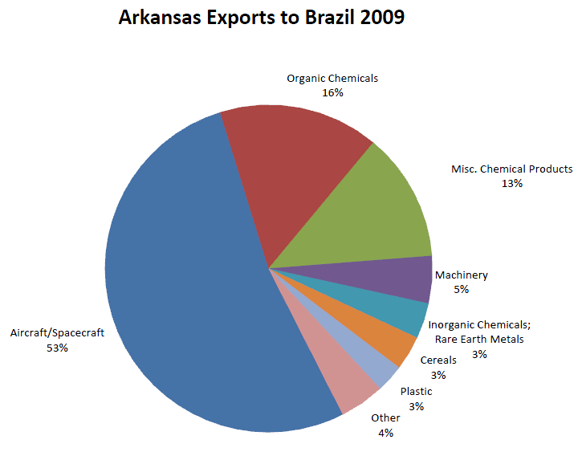

Slide 16
ARWTC Partners
Arkansas Economic Development Commission
U.S. Department of Commerce
Arkansas Export Assistance Center
Delta Center for Economic Development
Green Valley Network
State Universities
University of Arkansas Global Campus
Northwest Arkansas Council
Local and State Chambers of Commerce

Slide 17
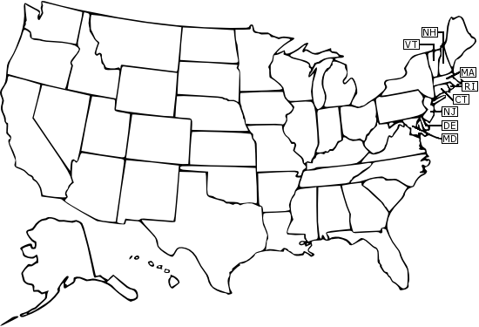
ARWTC Regional WTC Partners
Wichita
Dallas
Houston
New Orleans
Jackson
Memphis
Nashville
Lexington

Slide 18
ARWTC International Partners
The ARWTC currently has MOUs (memorandums of understanding) with:
World Trade Center Shenzhen (China)
World Trade Center Changzhou (China)
World Trade Center Mumbai (India)
World Trade Center East Lombardy, Brescia (Italy)
World Trade Center Pescara (Italy)

Slide 19
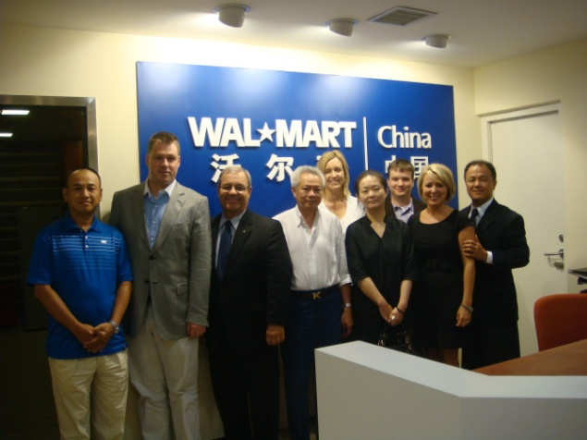
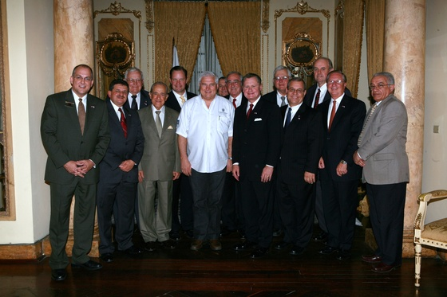
International Trade Missions
Past
China (2007, 2009, 2010)
India (2008)
Mexico (2008)
Peru and Brazil (2008)
Dubai, United Arab Emirates (2008)
Panama (2009, 2010)
Colombia & Panama (2010)
Future
China (April & Oct. 2011)
Latin America (Summer/Fall 2011)

Slide 20
China Trade Mission 2009
Walmart China Headquarters

Slide 21
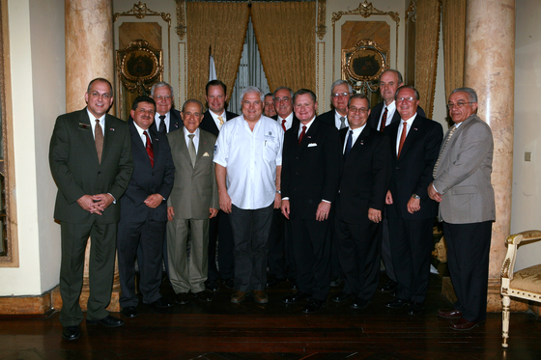
Panama Trade Mission 2009

Slide 22
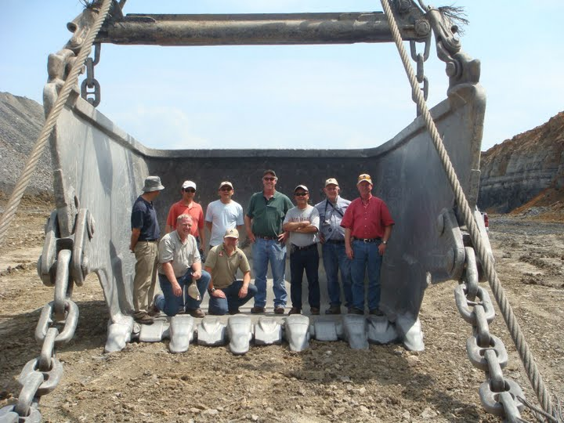
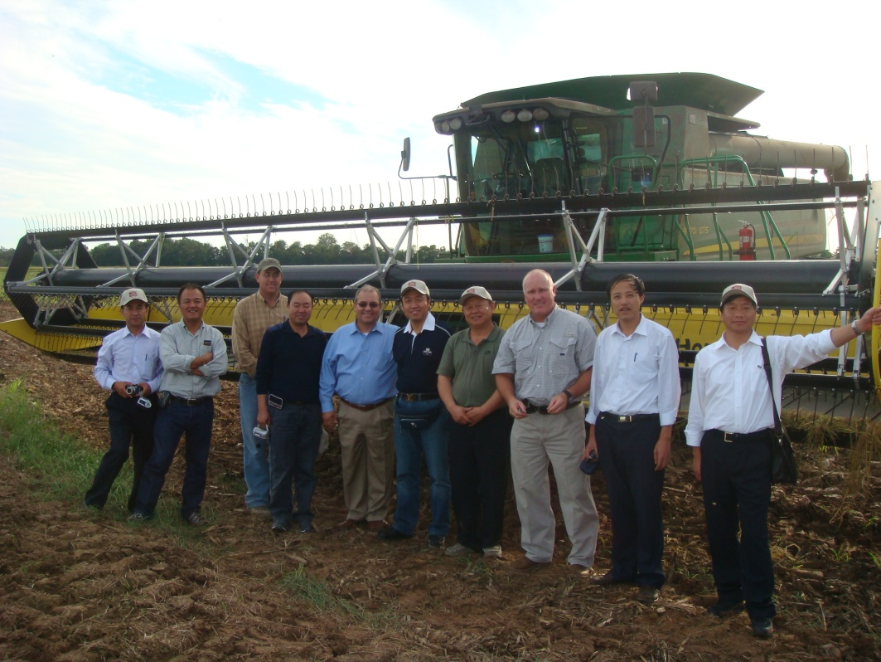
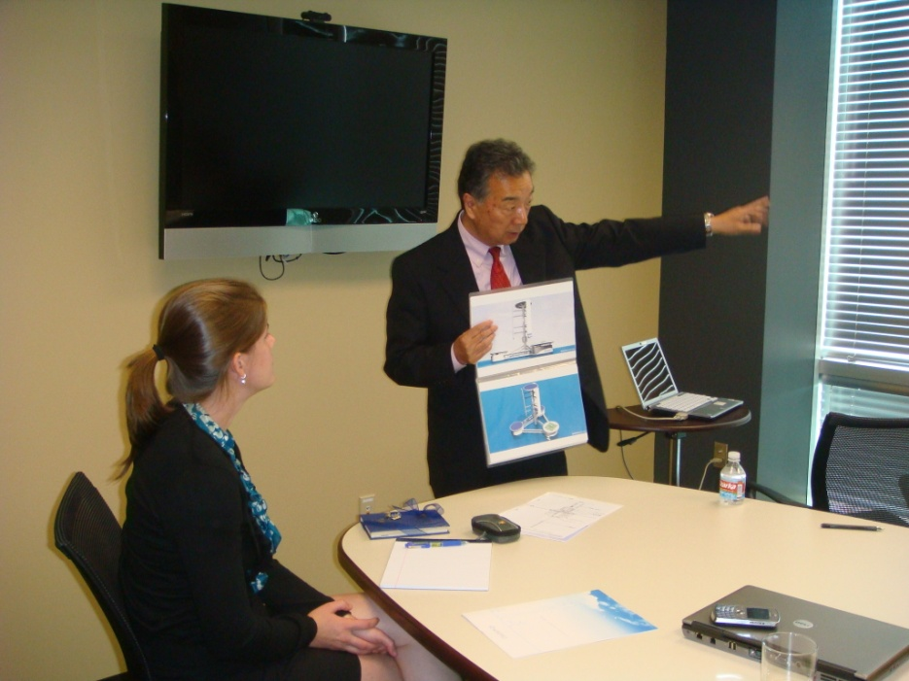
International Visitors
The ARWTC has hosted visitors from companies all over the world including:
China
Malaysia
Japan
India
Latin America

Slide 23
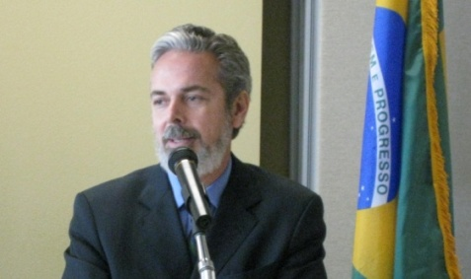
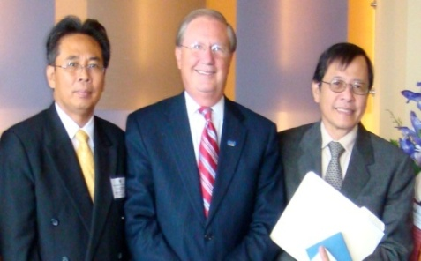
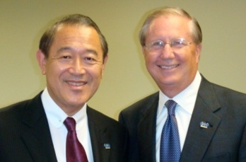
International Diplomats
Brazil– Antonio de Aguiar Patriota
Indonesia– Sudjadnan Parnohadiningrat
Japan– Ichiro Fujisaki
Ambassador to the U.S.
Ambassador to the U.S.
Ambassador to the U.S.

Slide 24
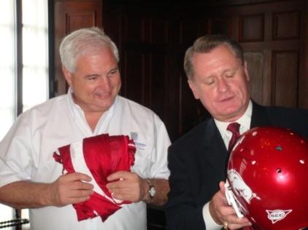
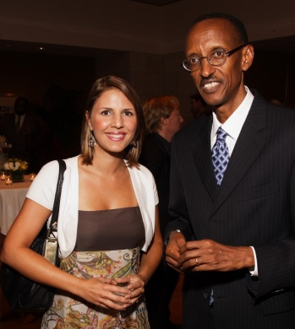
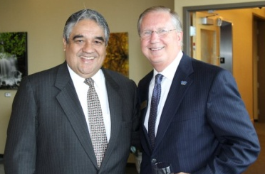
International Diplomats
Panama- Ricardo Martinelli
Rwanda- Paul Kagame
Peru- Luis Valdivieso
President of Panama
President of Rwanda
Ambassador to the U.S.

Slide 25
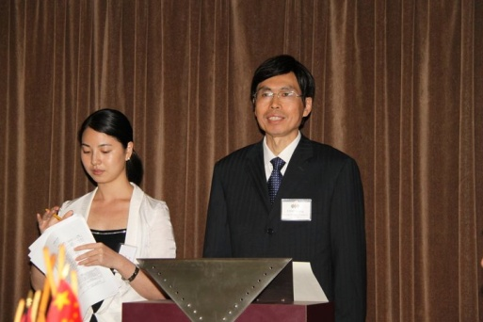
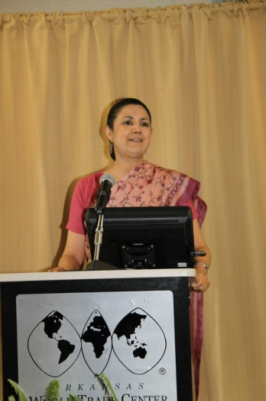
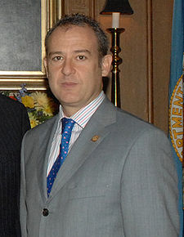
International Diplomats
China- Fang Aiqing
India- Meera Shankar
Mexico- Arturo Sarukhán
Asst. Minister of Commerce
Ambassador to the U.S.
Ambassador to the U.S.

