Slide 1
My story
Ningning Zhuang

Slide 2
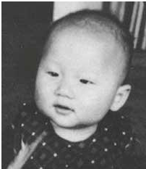
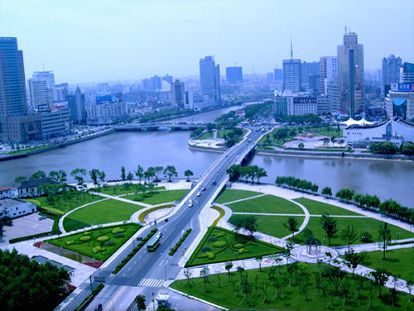
Name: Ningning Zhuang
Place of Birth: Ningbo, China

Slide 3
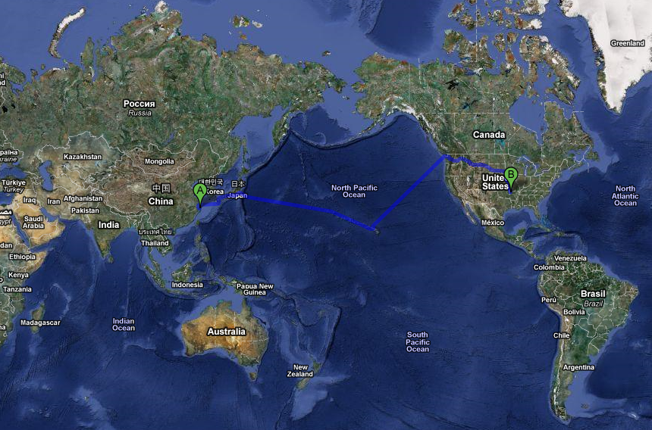

Slide 4
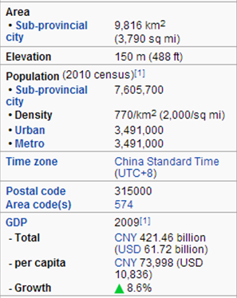
City of Ningbo

Slide 5
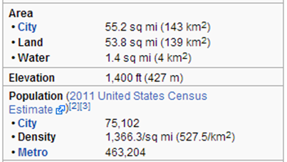
Ningbo vs. Fayetteville
Ningbo
Fayetteville

Slide 6
Industries of Ningbo
Textiles: Ningbo International Fashion Festival
Electrical products, Industrial tools:
Ningbo Economic & Technological Development Zone
Ningbo National Hi-Tech Industrial Development Zone
Ningbo Free Trade Zone
Nordic Industrial Park

Slide 7
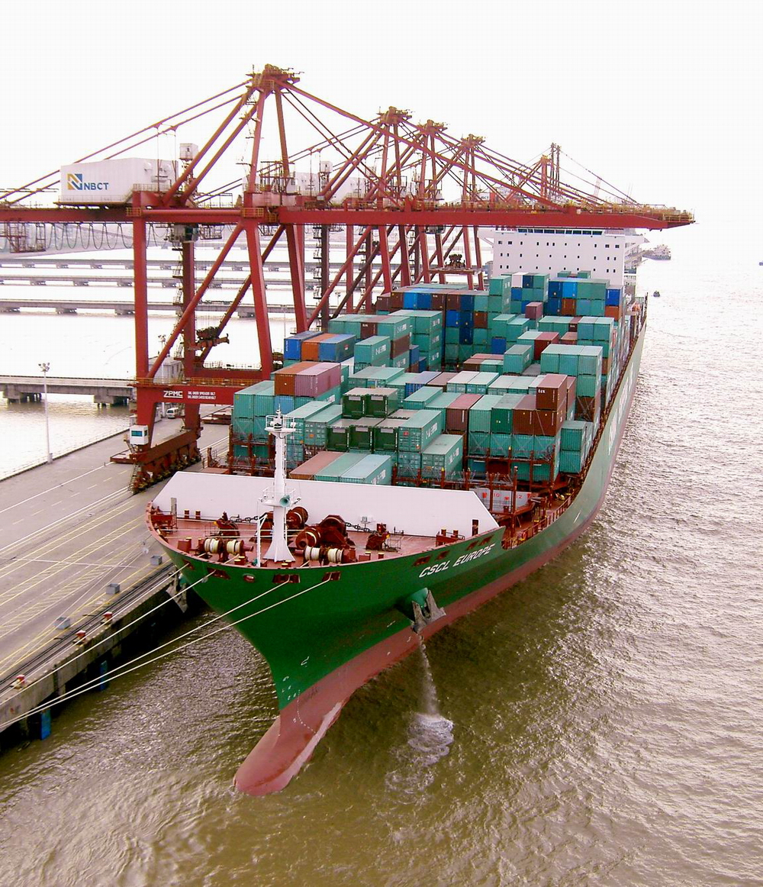
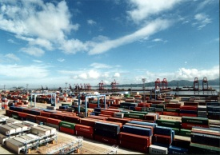
Port of Ningbo
A modern multi-purpose
deep water port

Slide 8
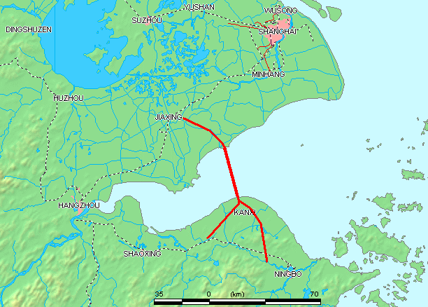
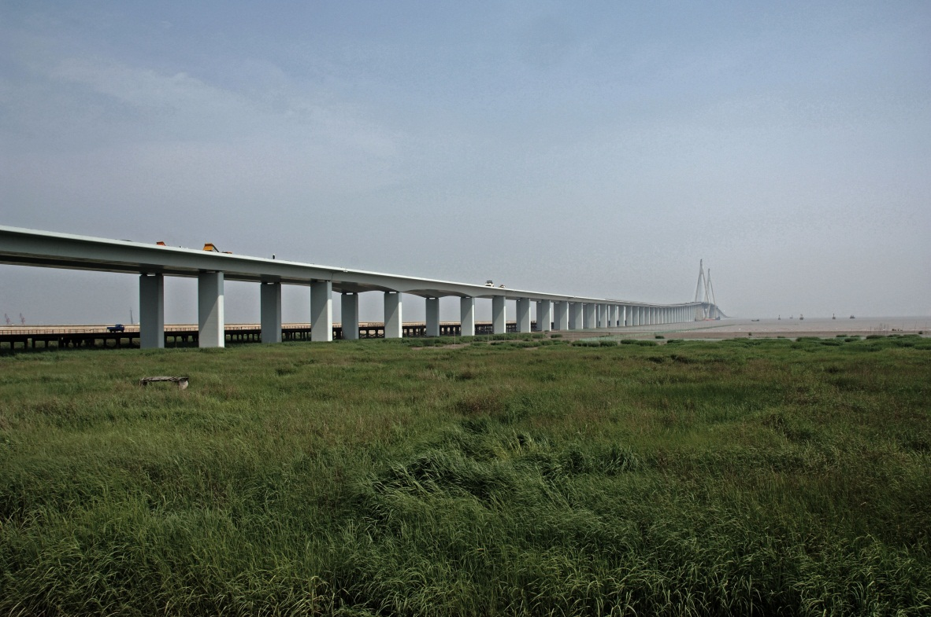
Hangzhou Bay Bridge
The longest trans-oceanic bridge
Almost 600 experts spent nearly a decade designing the bridge
Offshore construction
Weather
Toxic methane gas

Slide 9
Ancient & Modern
Tianyi Chamber: built in 1516; the oldest surviving library building in China

Slide 10
Tianyi Chamber
Its collection includes woodblock and handwritten copies of the Confucian classics, rare local histories and lists of the candidates successful in imperial examinations

Slide 11
Tianyi Square
The biggest multi-function square in China

Slide 12
Musical fountain
The highest musical fountain in Asia with a height of 40 meters (131.2335958 feet)

Slide 13
Downtown Ningbo

Slide 15
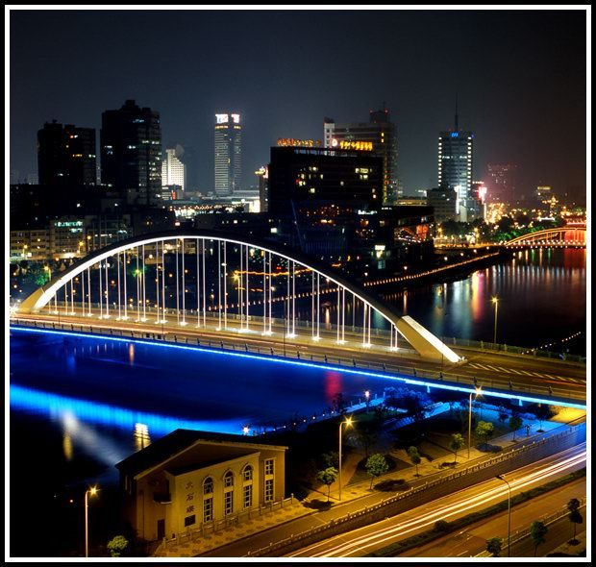

Slide 16
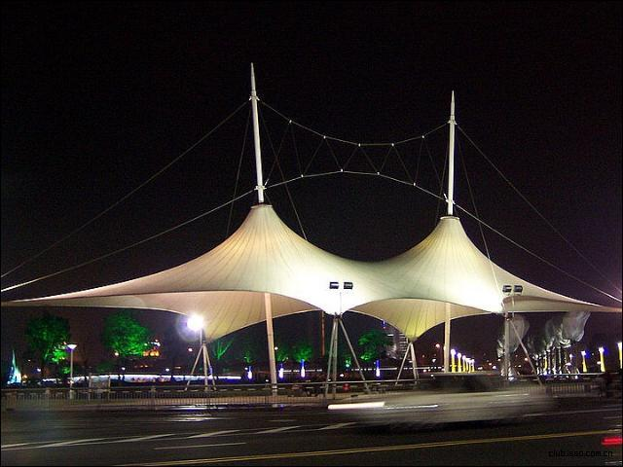

Slide 18
My family
A family of three

Slide 19
My parents
My father:
an elementary school P.E teacher
My mother:
a ship factory worker

Slide 21
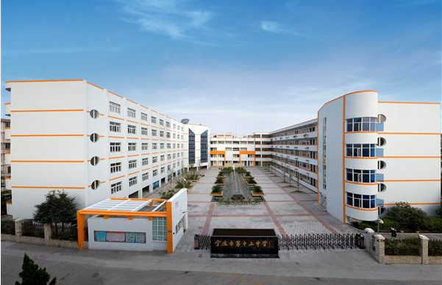
My elementary school
My middle school

Slide 22
My high school

Slide 23
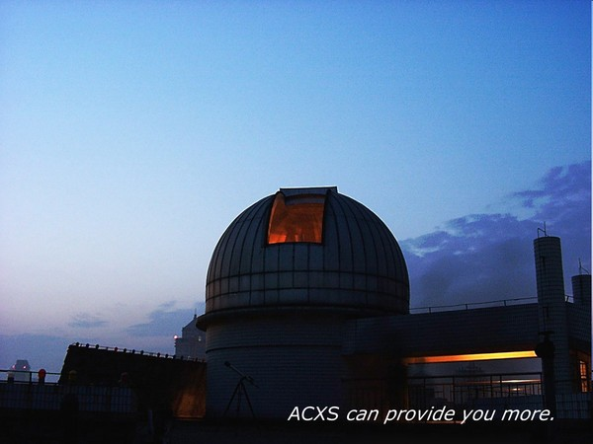
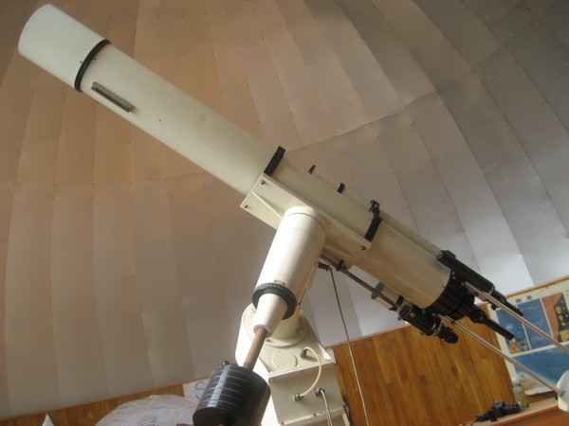

Slide 24
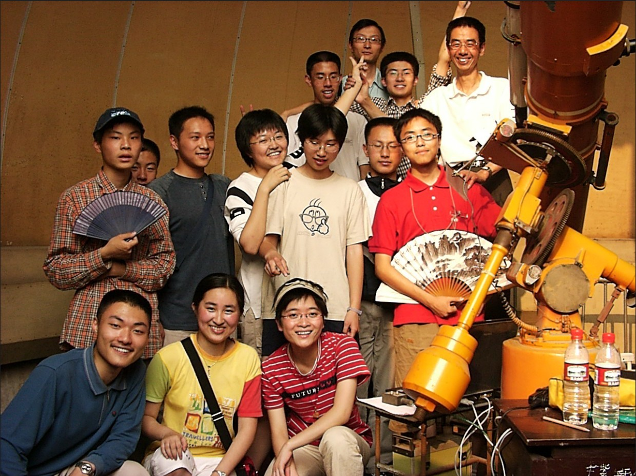

Slide 25
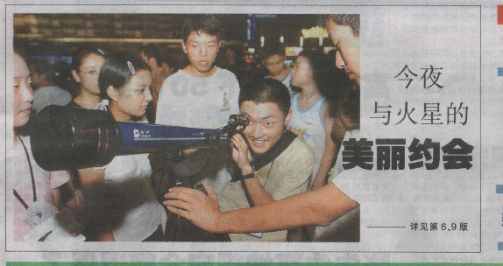

Slide 26
My college

Slide 27
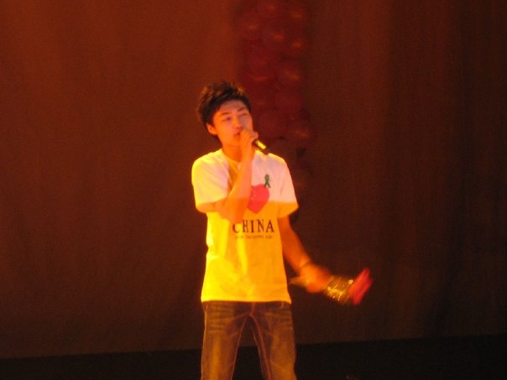

Slide 28
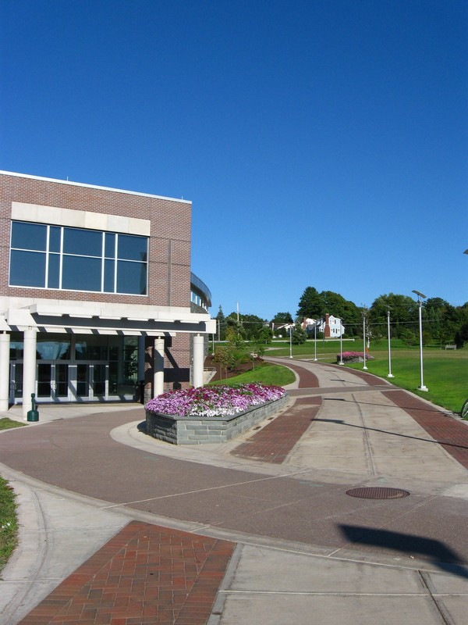
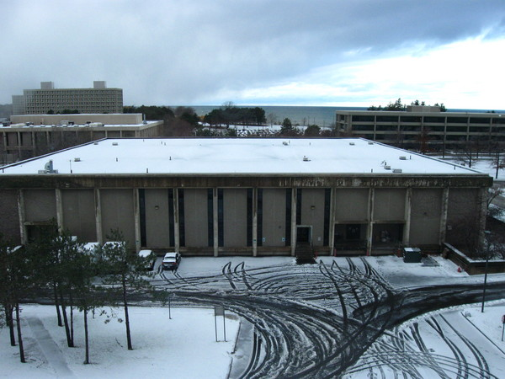
My college in USA

Slide 29
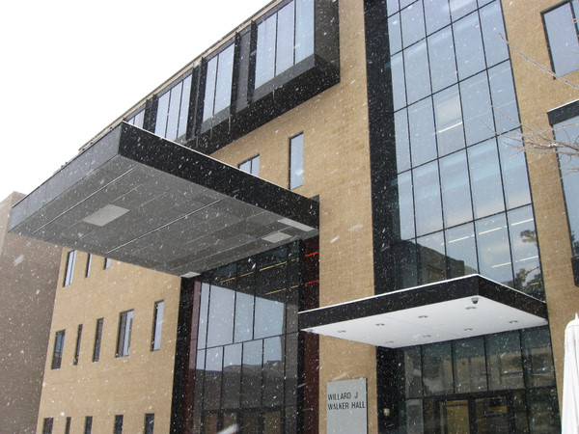
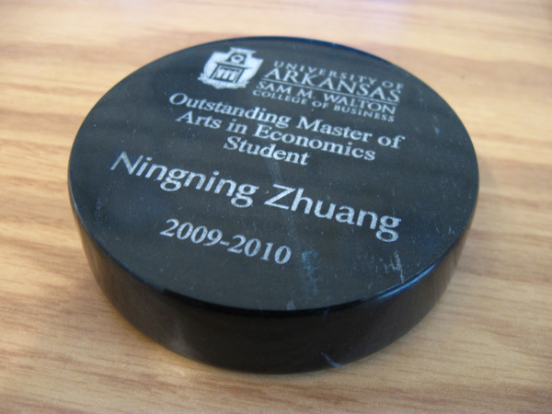
My graduate school

Slide 30
